Slide 1
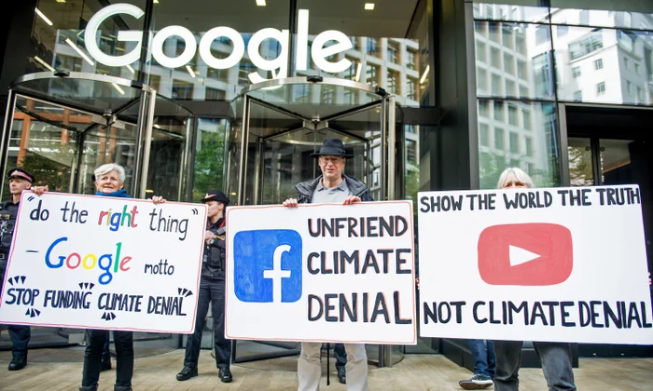
Google’s greenwashing tactics
Stop Vizag Data Centres - September 2026
By Ketan Joshi

Slide 2
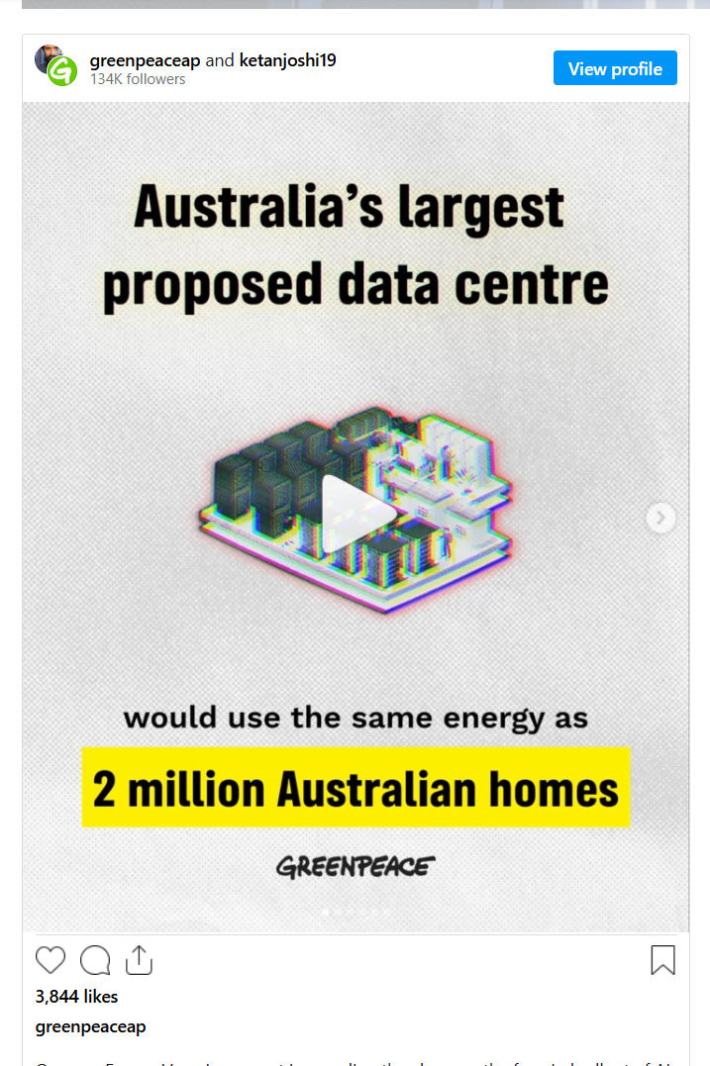
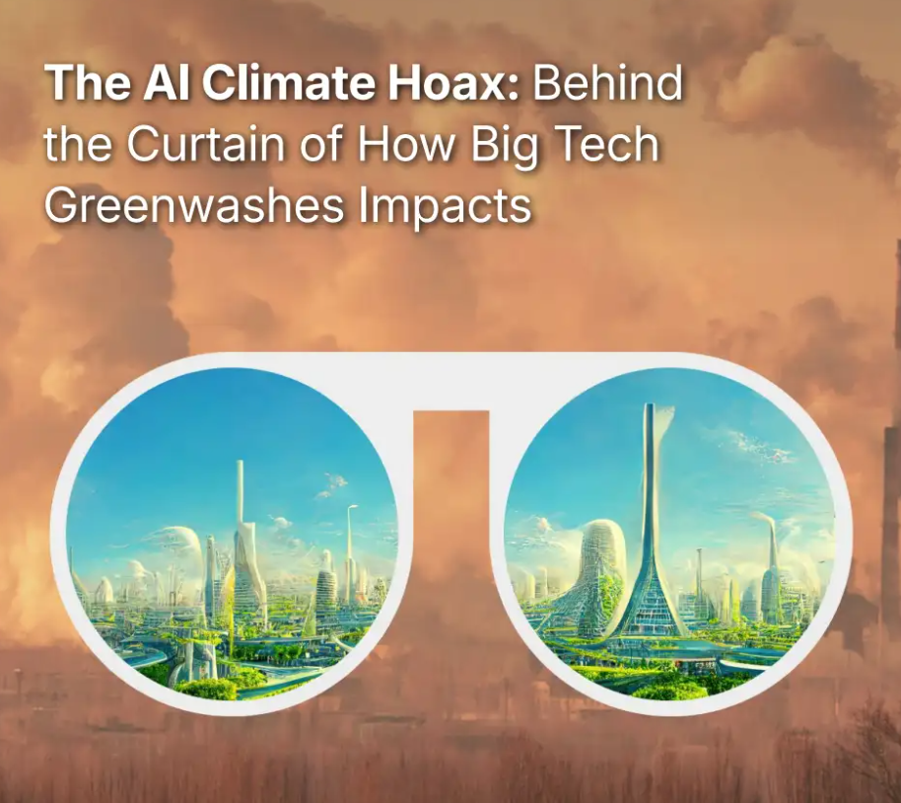
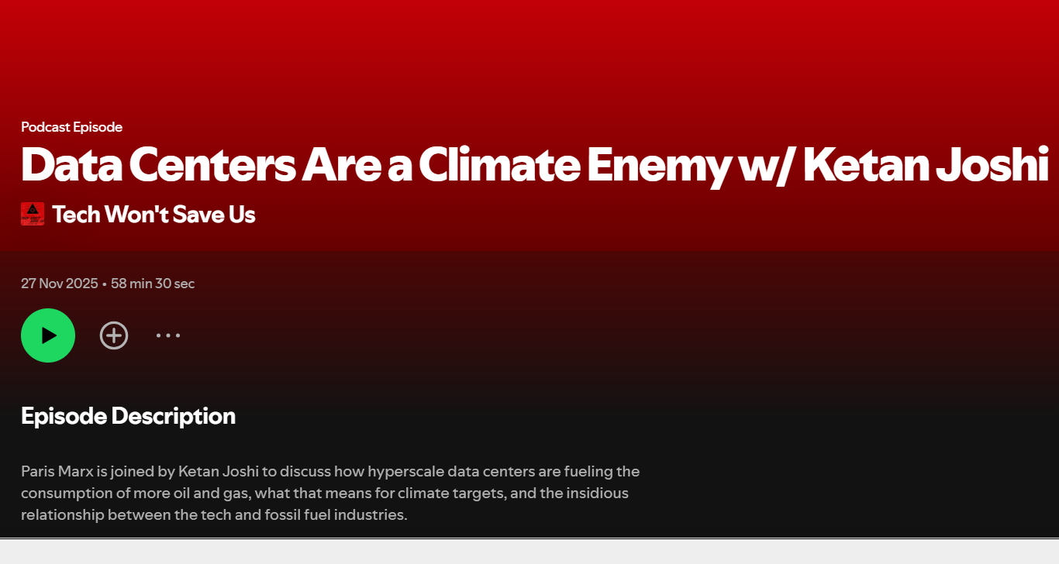

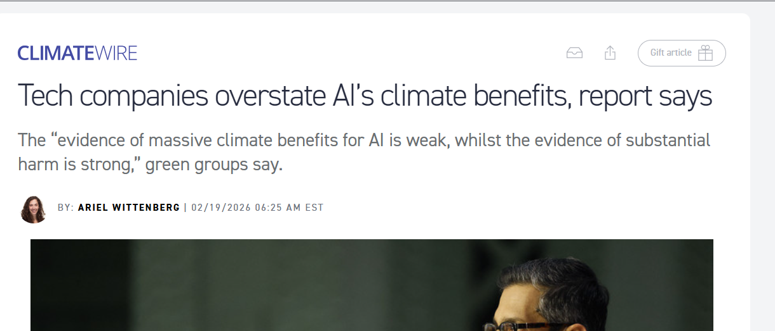
Who am I?
Ketan Joshi
Wind power, renewables advocacy – Australia, 2010 to 2018
Data science, AI communications – Australia, 2019
Corporate accountability, GSCC – Norway, 2021 to 2024
Independent analyst, writer and advocate – Norway, 2025 onwards
Feb 2026: “The AI Climate Hoax” (consortium; Stand, BFF, FoE, CAAD, GSC,GWF)
May 2026: “Energy Vampires” (Greenpeace Australia Pacific)
June 2026: Member of ‘Greenteaming AI Advisory Group’ (Mistra Environmental Communication)

Slide 3
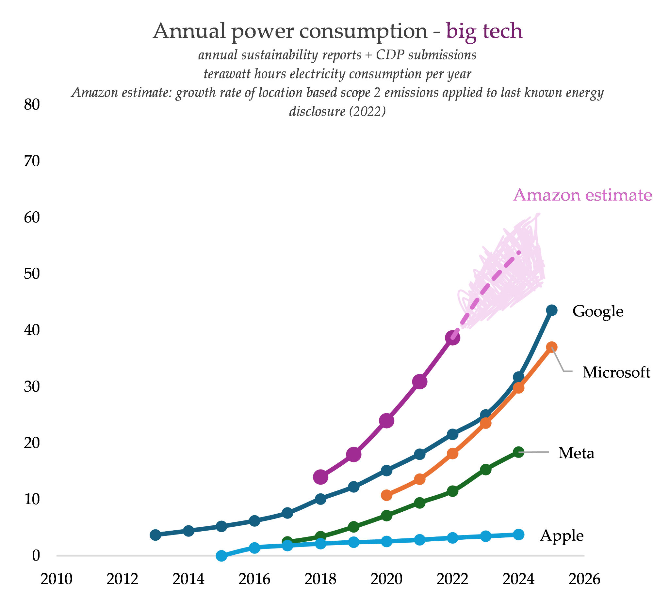
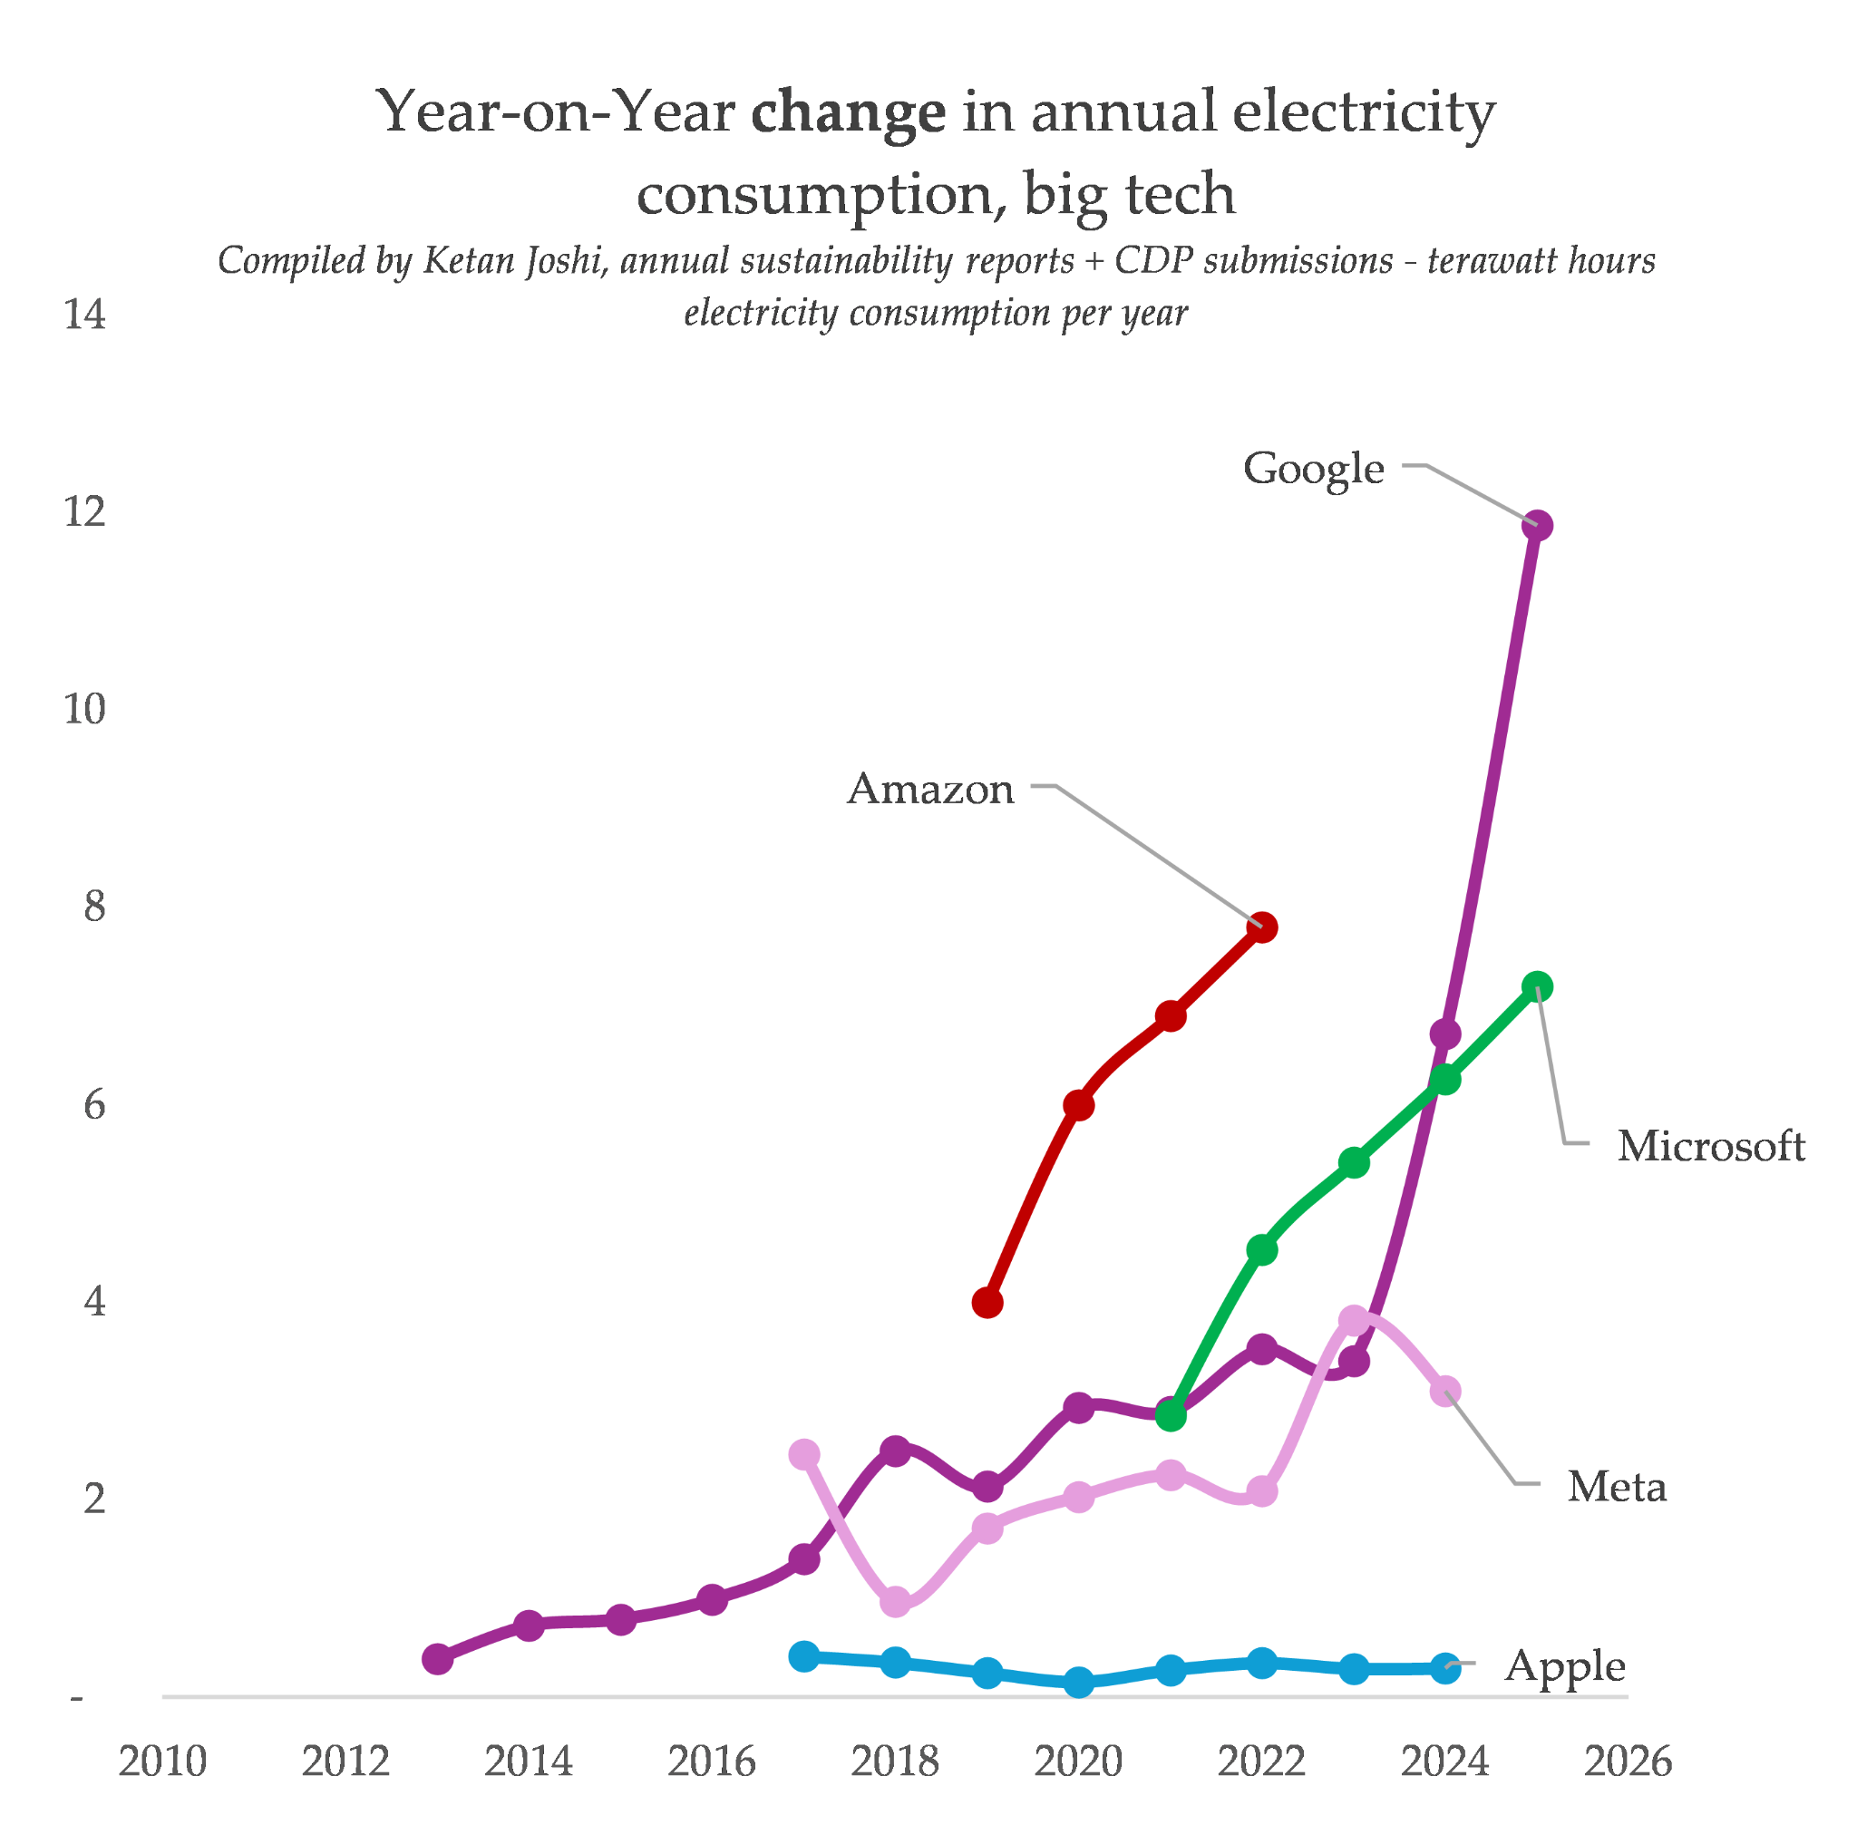
Part 1 – The current state of affairs
Why is big tech’s energy hunger growing?
Notes:
https://ketanjoshi.co/2025/05/23/data-collection-big-tech-emissions-energy/

Slide 4
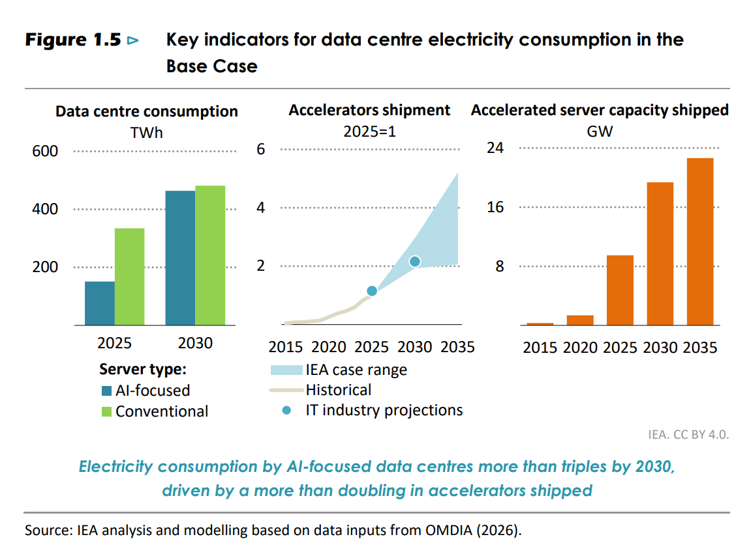
Part 1 – The current state of affairs
Growth mostly comes from GenAI
“Conventional” data centre growth: 2x
“AI” data centre growth: > 3x
Notes:
IEA - Key Questions on Energy and AI
https://www.iea.org/reports/key-questions-on-energy-and-ai

Slide 5
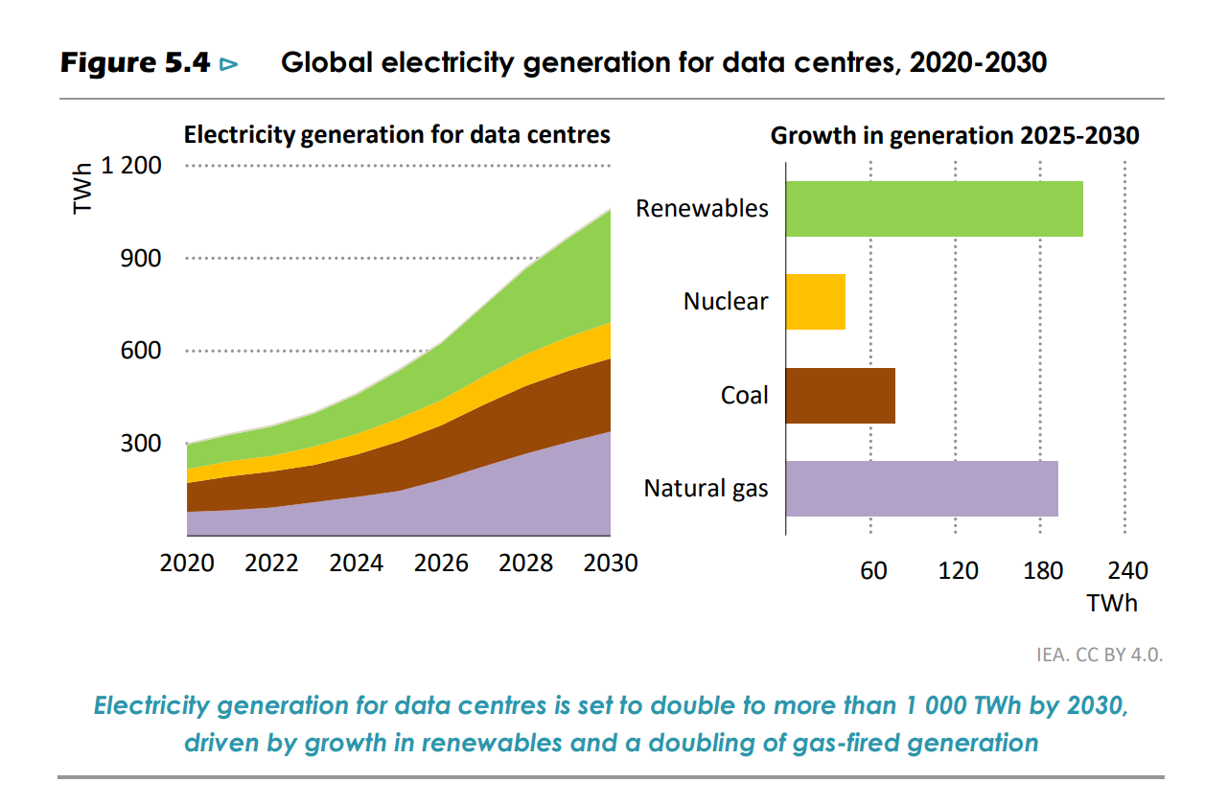
Part 1 – The current state of affairs
New data centres boost fossil fuels (grids)
2025 to 2030
Extra coal: ~75 TWh
Extra gas: 190 TWh
Additional GHGs
Coal: 62 MTCO2-e
Gas: 95 MTCO2-e
~avg 32 MTCO2-e per year
equivalent to adding an entire Netherlands power grid’s worth of emissions each year
Notes:
IEA - Key Questions on Energy and AI
https://www.iea.org/reports/key-questions-on-energy-and-ai
Author calculations

Slide 6
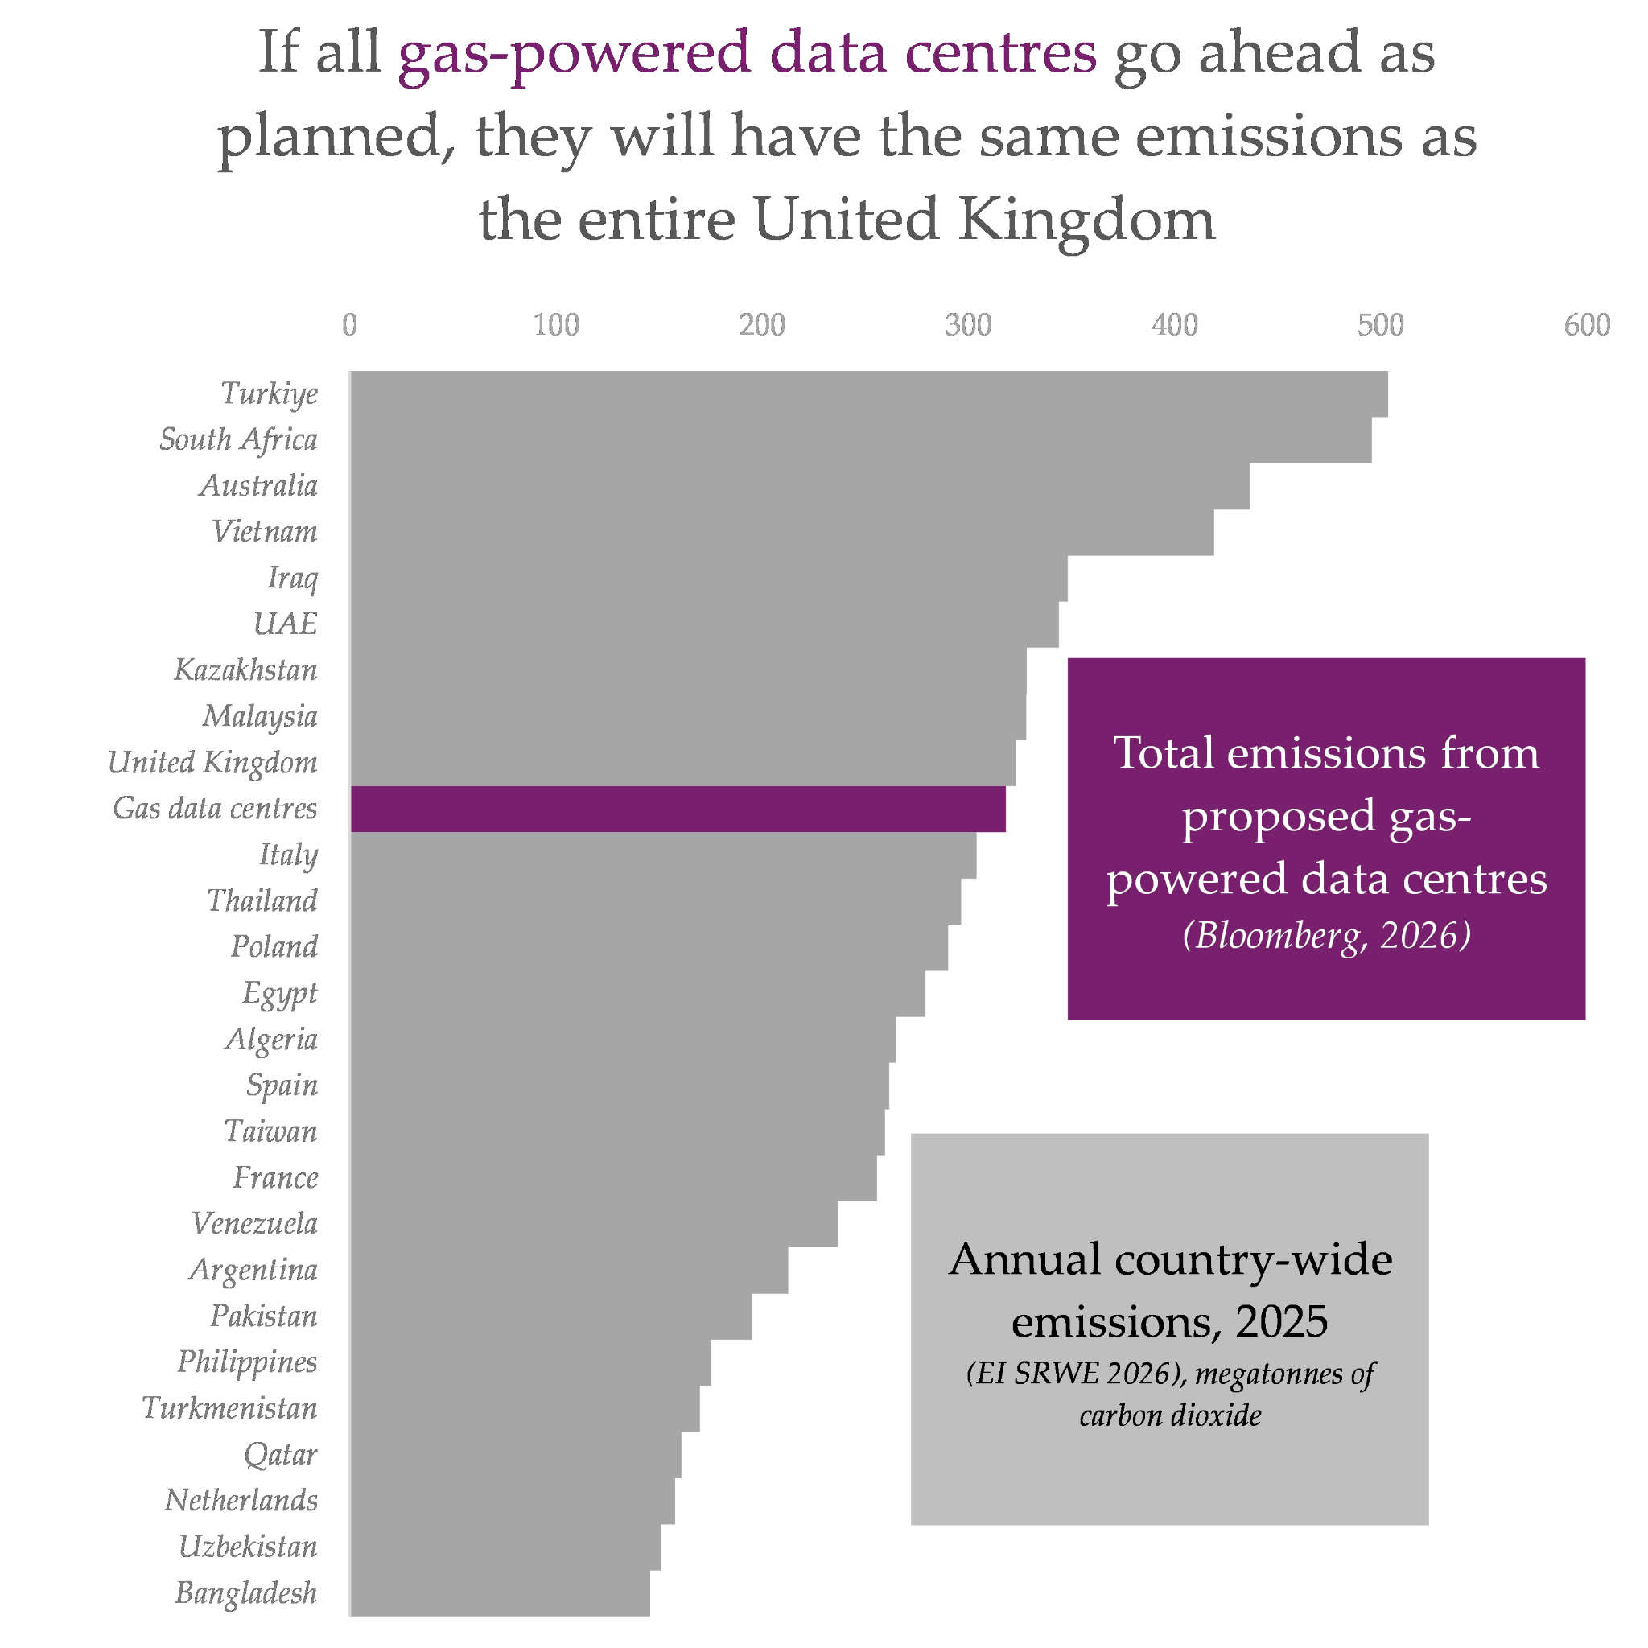

Part 1 – The current state of affairs
New data centres boost fossil fuels (gas)
Notes:
https://ketanjoshi.co/2026/09/16/nvidias-ai-climate-hoax-report/

Slide 7
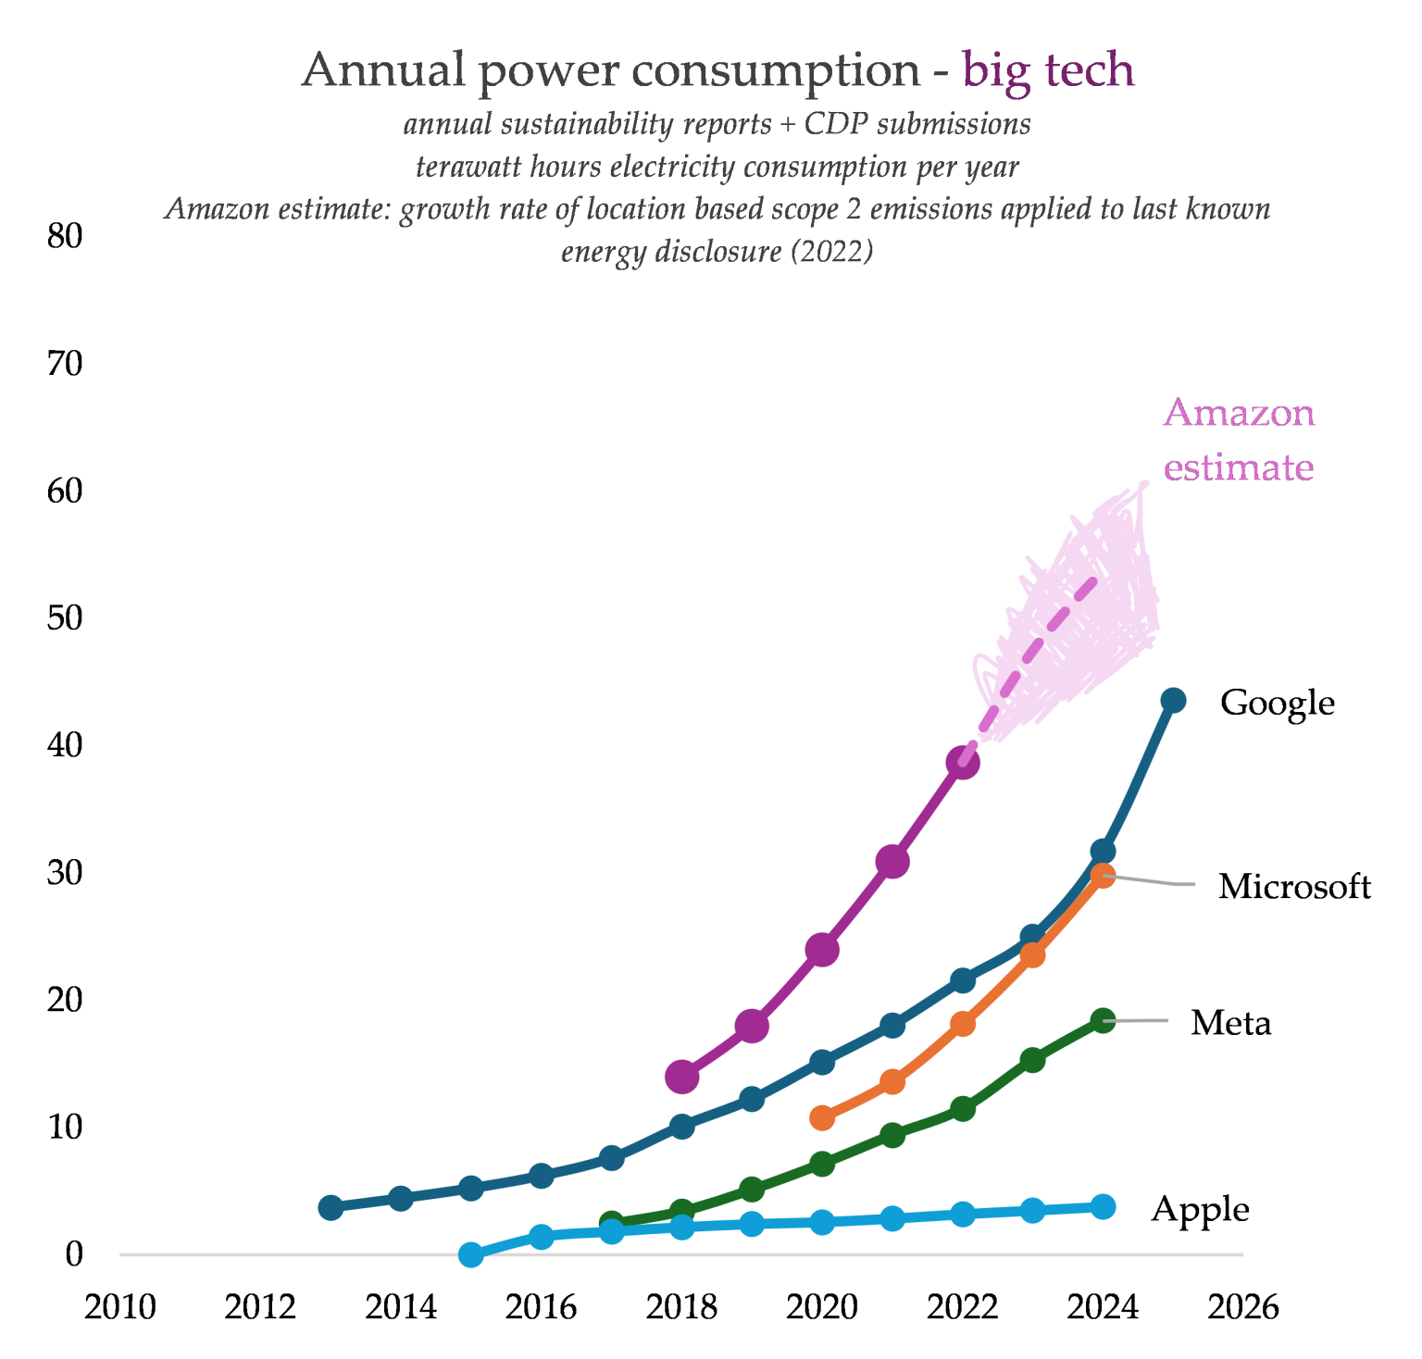
Part 2 – Google’s story
The company’s total electricity consumption jumped from 31 terawatt hours (TWh) in 2024 to 43 TWh in 2025.
This is very easily the biggest increase in their electricity consumption ever, and it puts them way ahead of Microsoft.
Notes:
https://ketanjoshi.co/2025/05/23/data-collection-big-tech-emissions-energy/

Slide 8
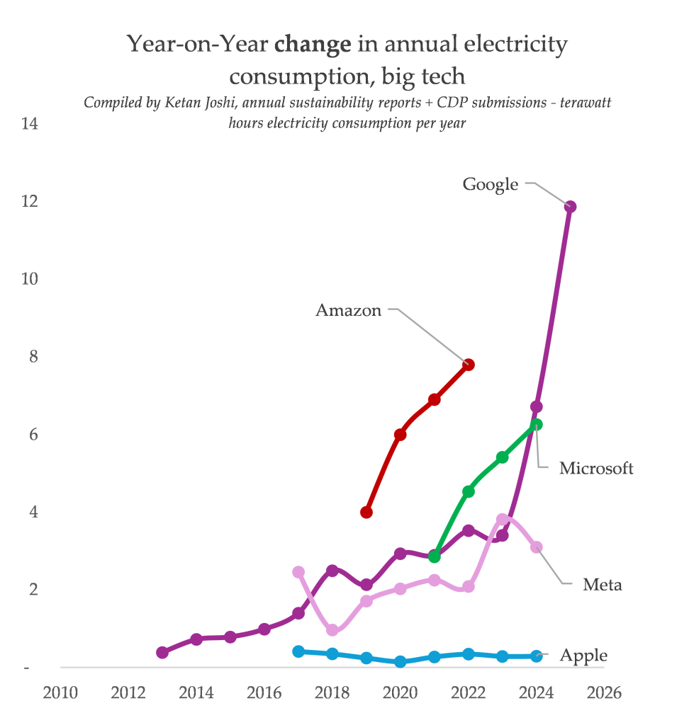
Part 2 – Google’s emissions
Google’s power consumption rose by 7 TWh between 2023 and 2024. That was bad.
But it rose by a whopping 12 TWh between 2024 and 2025, almost double last year’s increase.
Google’s power consumption isn’t just growing – the rate at which it is growing is growing. We have a word for this: exponential growth.
Notes:
https://ketanjoshi.co/2025/05/23/data-collection-big-tech-emissions-energy/

Slide 9
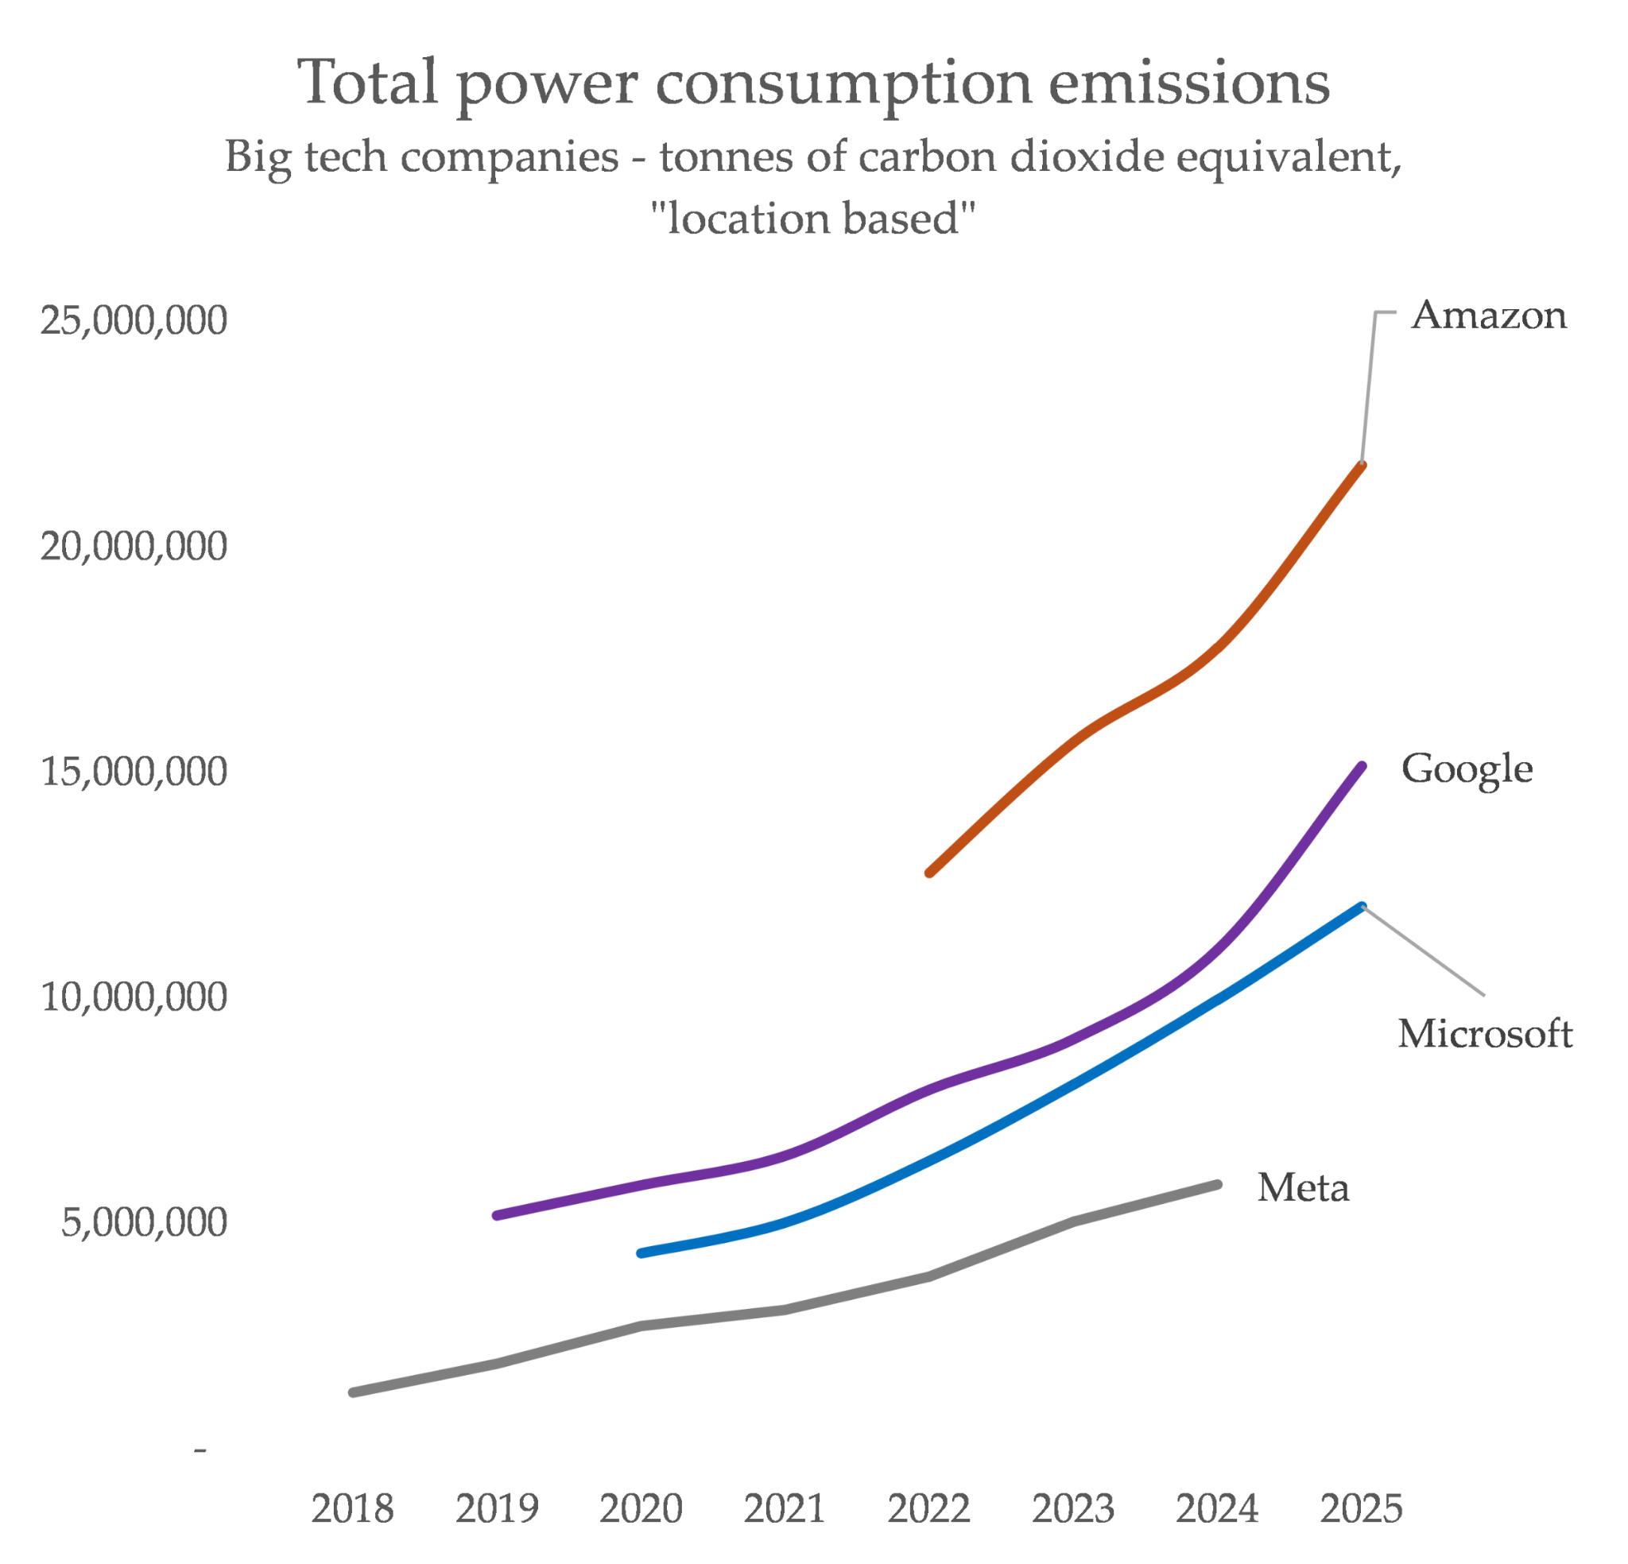
Part 2 – Google’s emissions
Google’s consumption is rising way faster than the grids are being cleaned up with renewables, and that means their emissions number is going up fast, too.
It’s the steepest rise on record
Notes:
https://ketanjoshi.co/2025/05/23/data-collection-big-tech-emissions-energy/

Slide 10

Part 2 – Google’s Greenwashing Story
‘AI will save climate’
Energy Efficiency claims
Renewable claims

Slide 11
Part 2 – Google’s Greenwashing Story
‘AI will save climate’
Energy Efficiency claims
Renewable claims

Slide 12
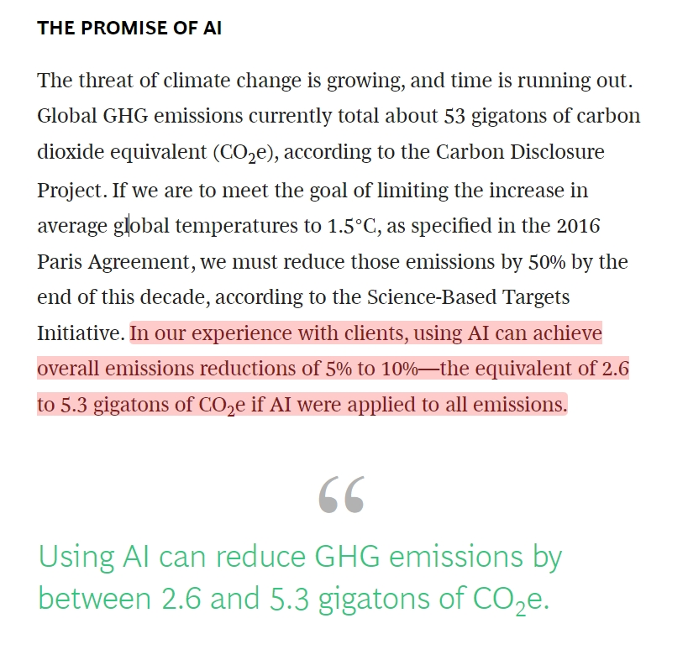
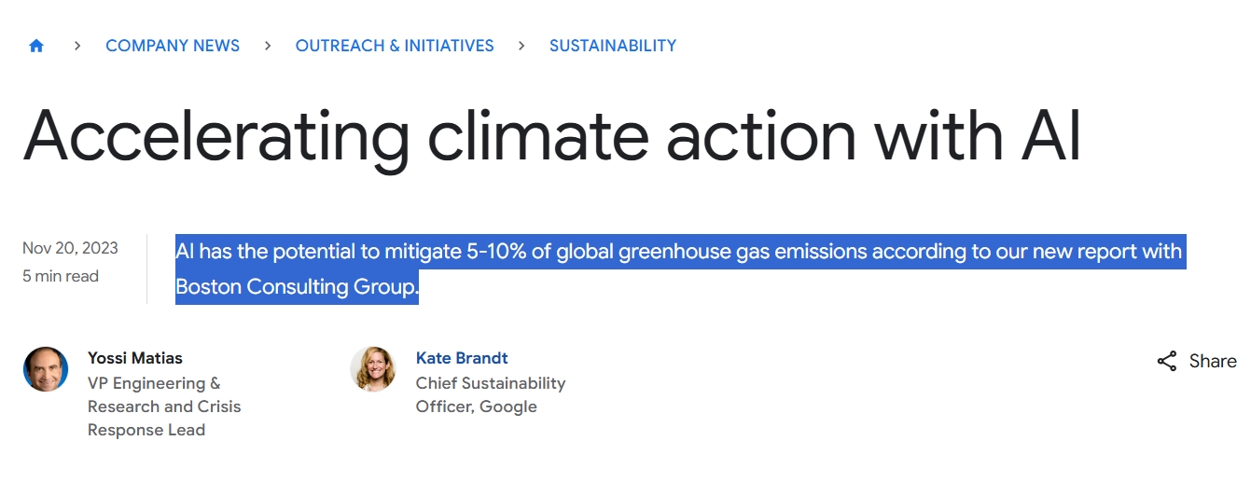
Part 2 – Google’s Greenwashing Story - ‘AI will save climate’
Notes:
https://ketanjoshi.co/2026/07/01/googles-exponential-path-to-climate-wrecking-digital-bloat/

Slide 13
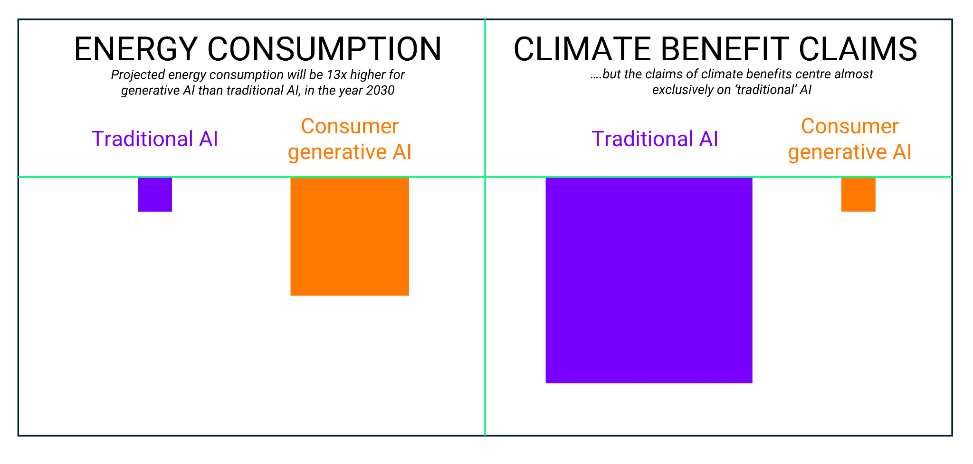
Part 2 – Google’s Greenwashing Story - ‘AI will save climate’
Notes:
https://ketanjoshi.co/2026/02/17/big-tech-greenwashing-report/

Slide 14

Part 2 – Google’s Greenwashing Story - ‘AI will save climate’
TACTICAL
VAGUENESS
Notes:
https://ketanjoshi.co/2026/02/17/big-tech-greenwashing-report/

Slide 15
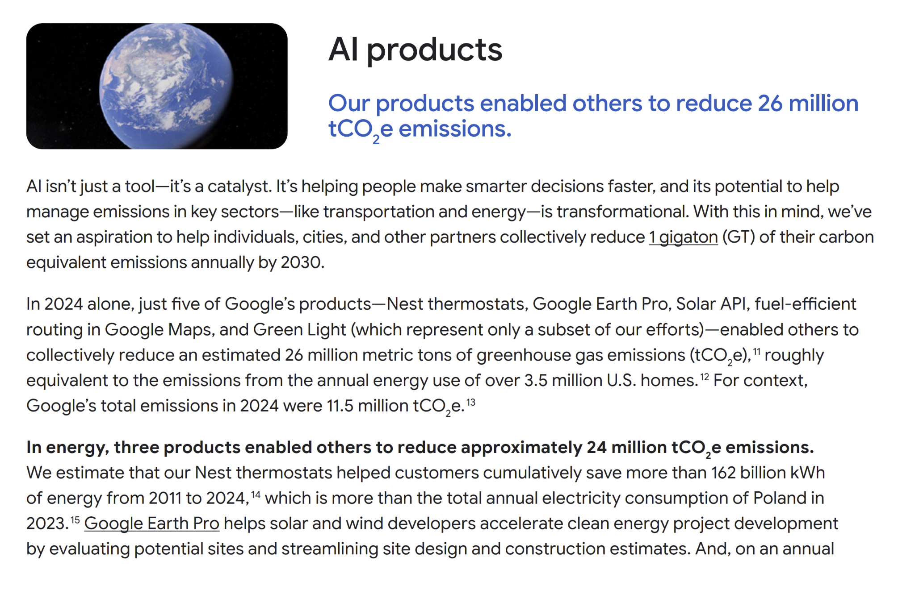
Part 2 – Google’s Greenwashing Story - ‘AI will save climate’
“Our products enabled others to reduce 26 million tCO2e emissions…...for context, Google’s total emissions in 2024 were 11.5 million tCO e”
Nest thermostats
Google Earth Pro
Solar API
Google maps routing
Traffic light timing
All ‘traditional’ AI
Notes:
https://ketanjoshi.co/2026/02/17/big-tech-greenwashing-report/

Slide 16
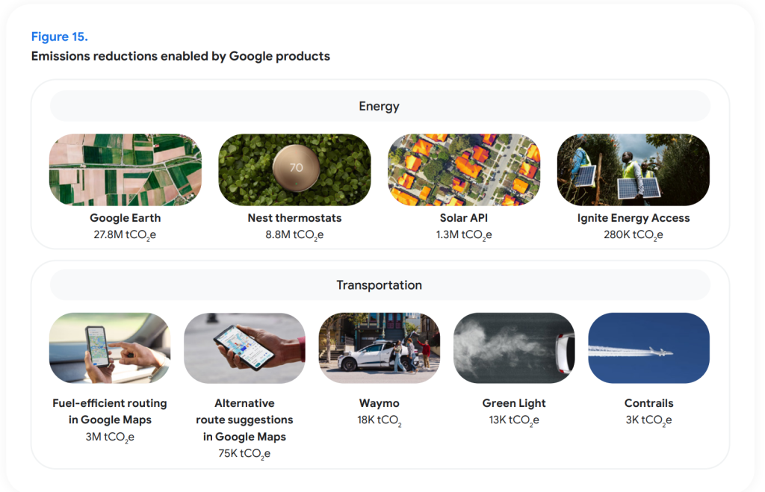
Part 2 – Google’s Greenwashing Story - ‘AI will save climate’
Google’s total claim for emissions reductions “enabled” by their products is a whopping 41 million megatonnes of CO2-e, more than the company’s entire footprint by a good margin.
Most of this comes from the extremely absurd claim that Google Earth (!) enables the siting of clean energy projects – and so Google claims credit for the entire emissions reductions of all those projects for the full year of 2025
Notes:
https://ketanjoshi.co/2026/07/01/googles-exponential-path-to-climate-wrecking-digital-bloat/

Slide 17
Part 2 – Google’s Greenwashing Story
‘AI will save climate’
Energy Efficiency claims
Renewable claims

Slide 18
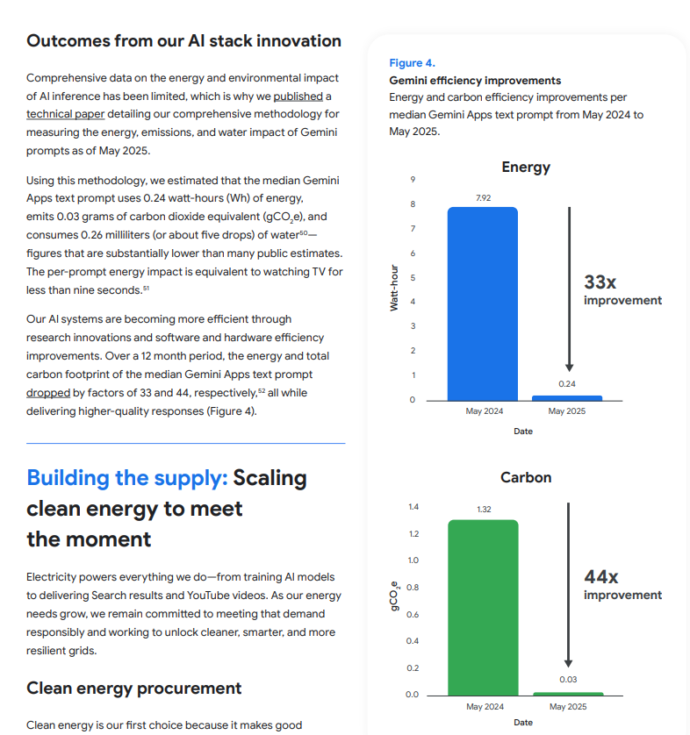
Part 2 – Google’s Greenwashing Story - Efficiency-washing
Google repeat the tactically narrow focus on single queries, intended to present a clearly misleading visual of reduced impact
Notes:
https://ketanjoshi.co/2026/07/01/googles-exponential-path-to-climate-wrecking-digital-bloat/

Slide 19
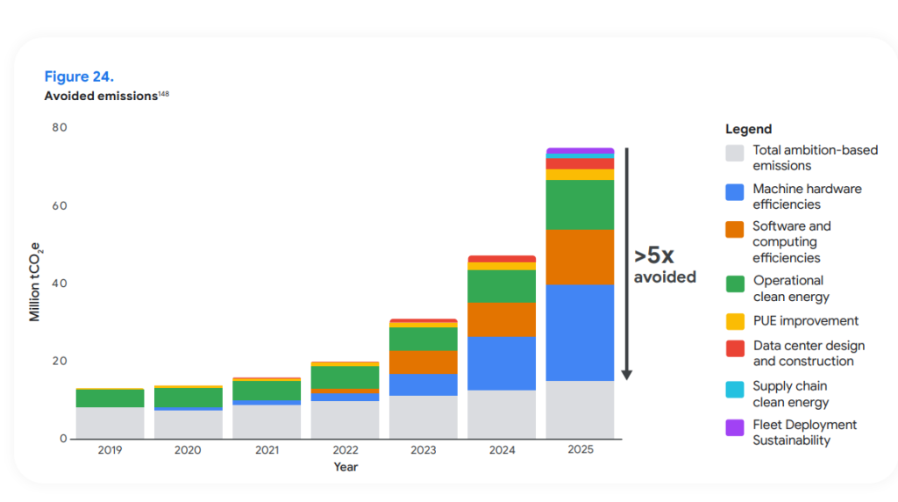
Part 2 – Google’s Greenwashing Story - Efficiency-washing
Notes:
https://ketanjoshi.co/2026/07/01/googles-exponential-path-to-climate-wrecking-digital-bloat/

Slide 20
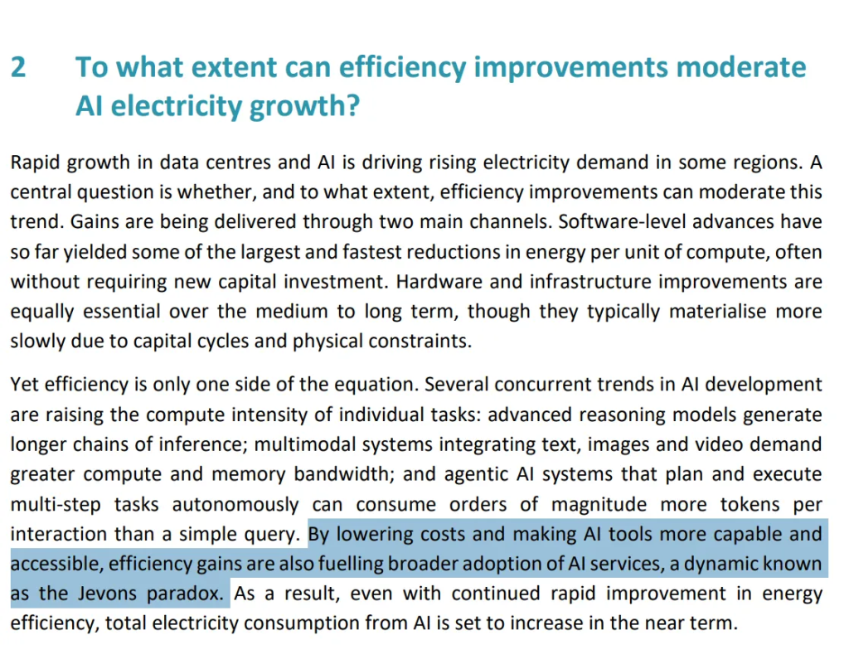
Part 2 – Google’s Greenwashing Story - Efficiency-washing
Notes:
https://www.iea.org/reports/key-questions-on-energy-and-ai

Slide 21
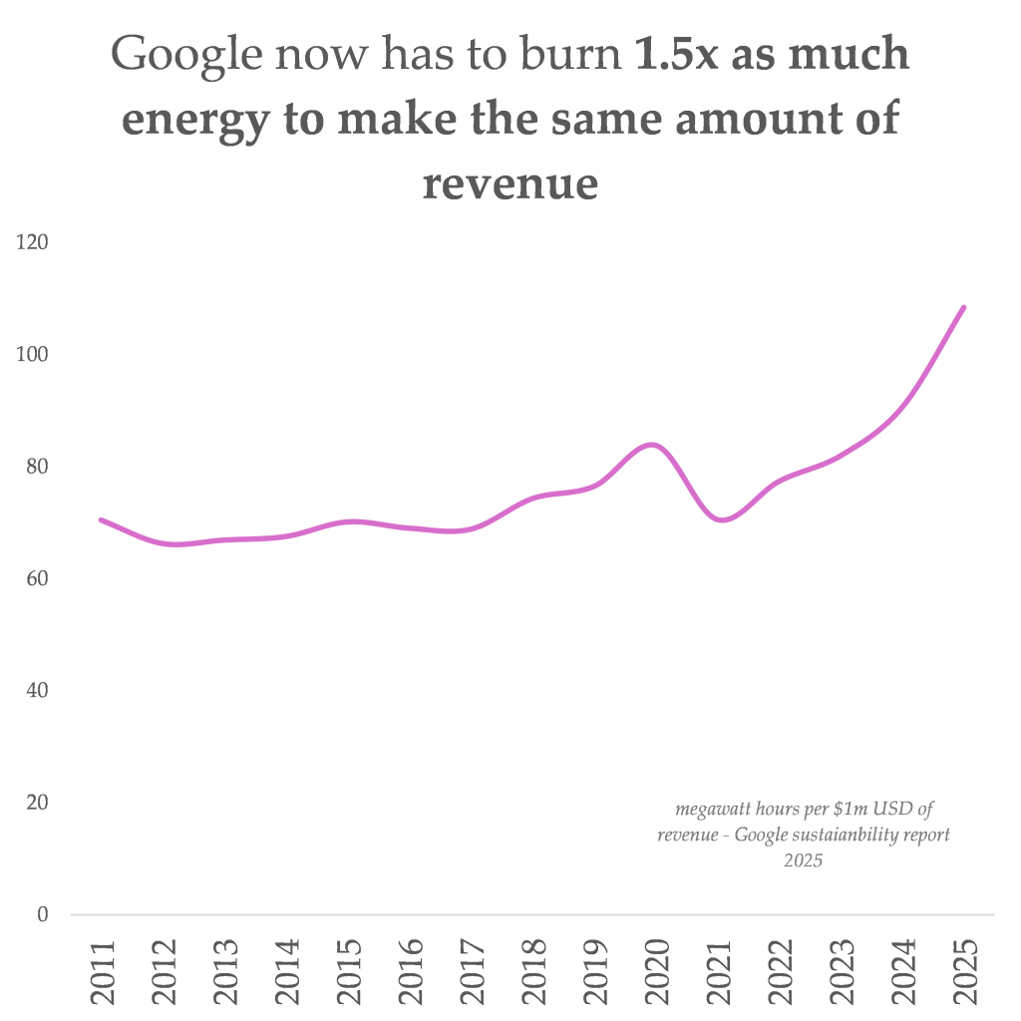
Part 2 – Google’s Greenwashing Story - Efficiency-washing
Notes:
https://ketanjoshi.co/2026/07/01/googles-exponential-path-to-climate-wrecking-digital-bloat/

Slide 22
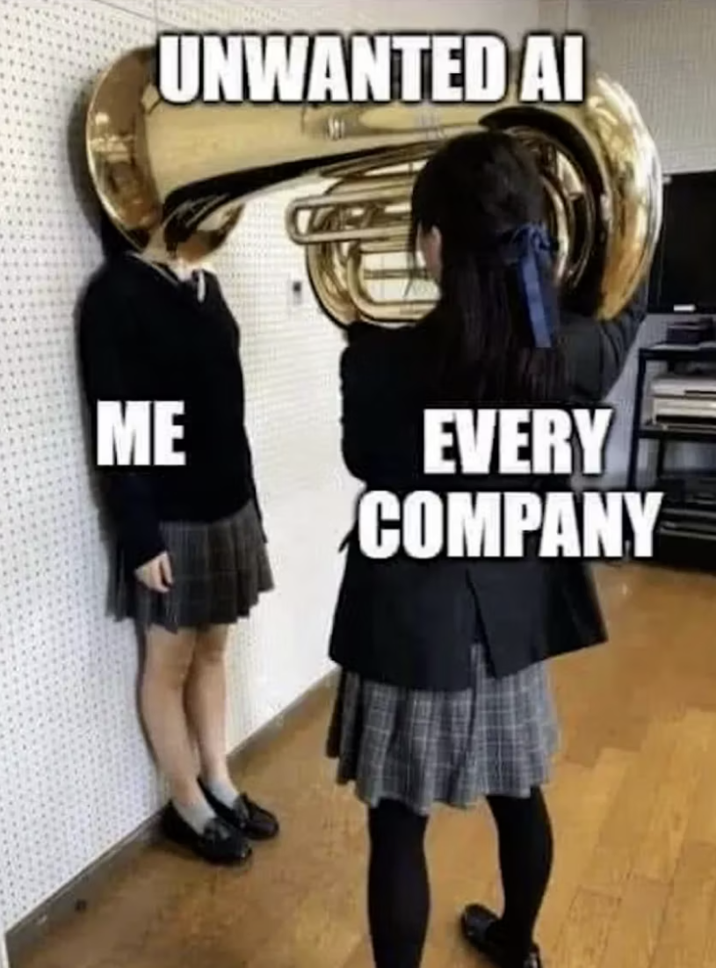

Part 2 – Google’s Greenwashing Story - Efficiency-washing
Notes:
https://ketanjoshi.co/2025/08/23/big-techs-selective-disclosure-masks-ais-real-climate-impact/

Slide 23
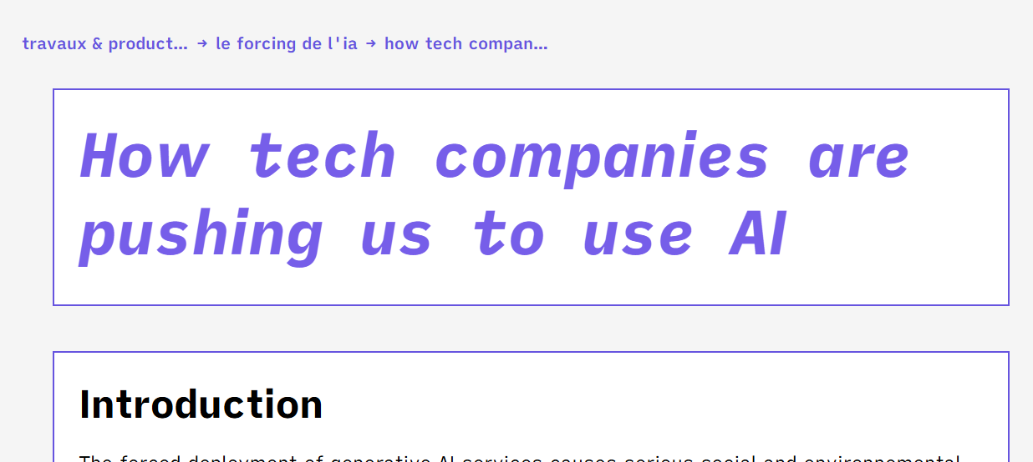
Part 2 – Google’s Greenwashing Story - Efficiency-washing
Notes:
https://limitesnumeriques.fr/travaux-productions/ai-forcing/en

Slide 24
Part 2 – Google’s Greenwashing Story
‘AI will save climate’
Energy Efficiency claims
Renewable claims

Slide 25
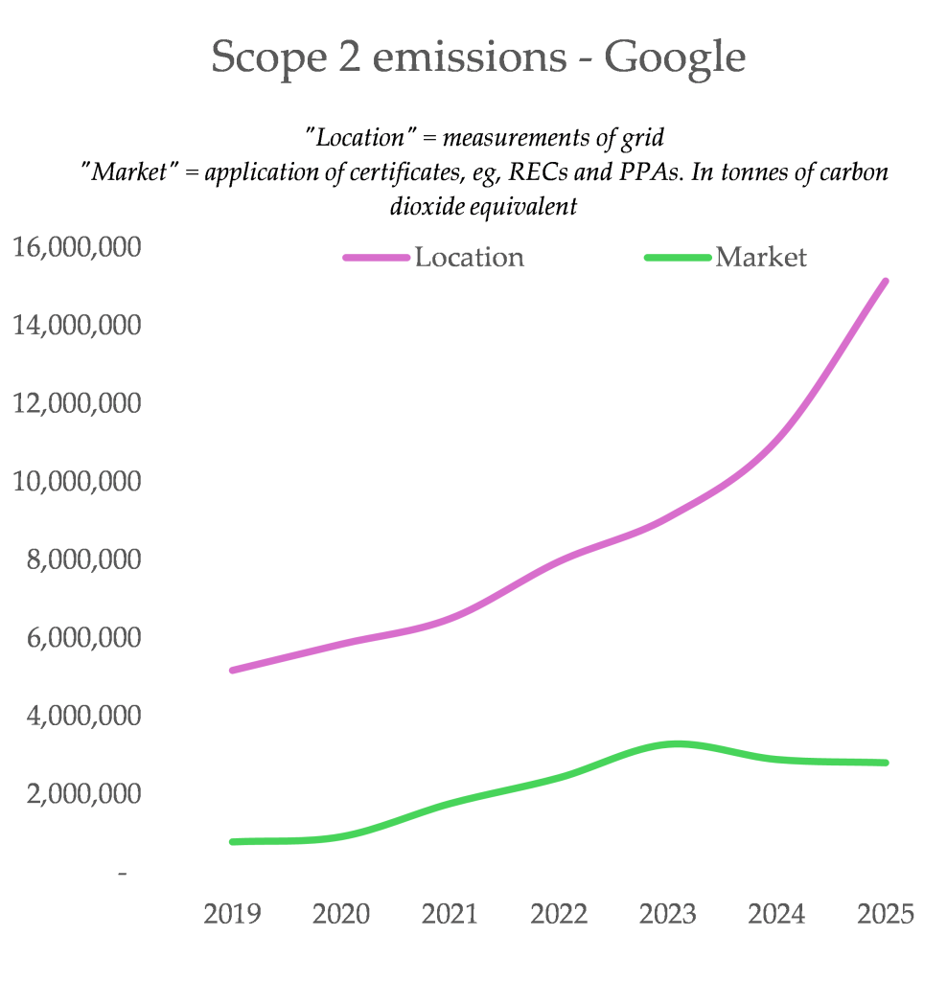
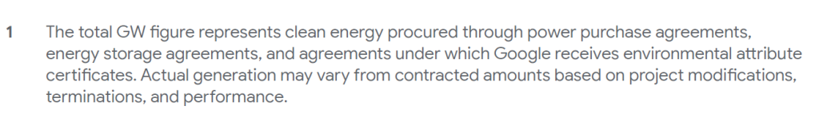
Part 2 – Google’s Greenwashing Story - Renewable claims
Google have been far less bad than many other technology companies, supporting large-scale clean energy projects and long-duration energy storage. They also support greater efforts to more closely match power consumption to renewable generation. On the flipside, Google has been pouring cash into gas and blatantly-not-going-to-happen CCS and fusion projects.
Notes:
https://ketanjoshi.co/2026/07/01/googles-exponential-path-to-climate-wrecking-digital-bloat/

Slide 26
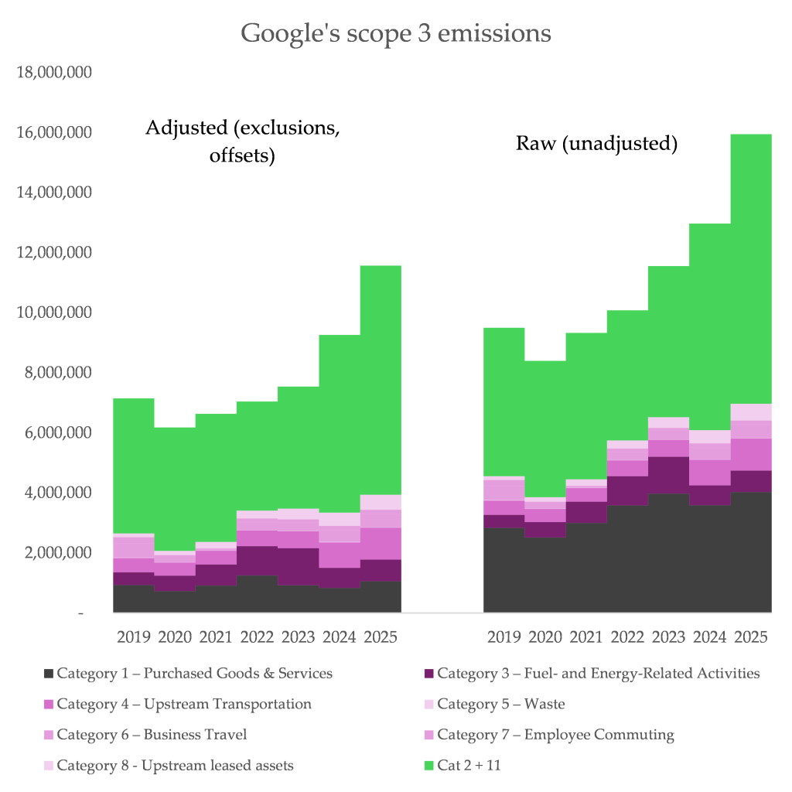
Part 2 – Google’s Greenwashing Story - Renewable claims
They exclude much of the good and services they purchase from third parties on the grounds they can’t influence them. But they don’t disclose exactly what these are, so we can’t really check.
Notes:
https://ketanjoshi.co/2026/07/01/googles-exponential-path-to-climate-wrecking-digital-bloat/

